Slide 1
Course Name: Cyber & Virtual Concept- Info 400
Instructor: T. Hilary M. Johnny
Date: Saturday 9:00-12:00 pm and 4:30:8:00 TH
Course code: INFO 400
joclicacm@gmail.com
0778616504/0886536114

Slide 2
What is a server
A server as the name depicts, is a dedicated computer that serves information to other computers. These computers, called clients, can connect to a server through either a local area network or a wide area network like the internet. The servers in a datacenter are placed in units called rack. The place where the drives inserted are called bays. Like any other computer, the servers has all parts inclusive of motherboard, RAM, HDD CPU and etc.

Slide 3
What is a server
It is a big, powerful computer that is designed to communicate with other computers unlike the PCs that are designed to communicate with humans.

Slide 4
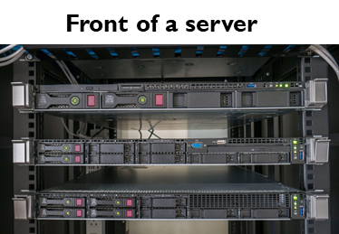
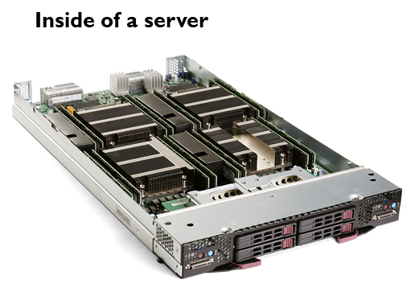
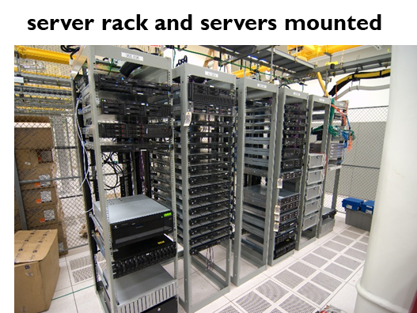
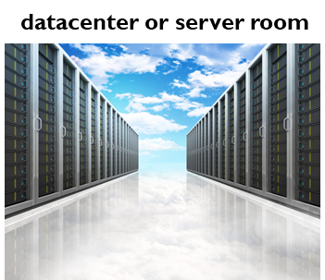

Slide 5
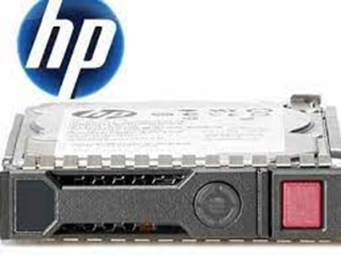
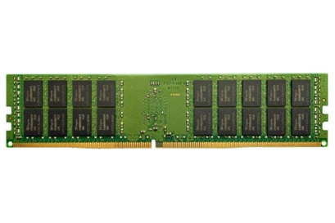
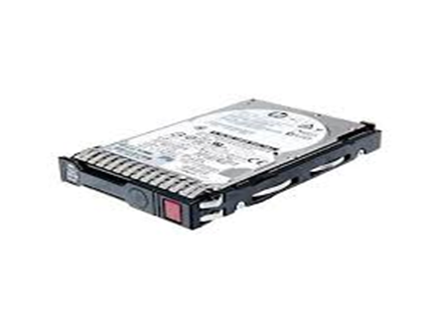

Slide 6
What is Virtualization Technology?
Is a technology that lets you create useful IT services like operating systems using resources that are traditionally bound to single hardware. It allows you to use a physical machine’s full capacity by distributing its capabilities among many resources. These operating systems are completely separated and independent from each other.

Slide 7
What is Virtualization Technology?
This technology it makes possible to install multiple OS, multiple software and multiple applications on a single physical machine.
The physical hardware must have good specifications depending on the number of resources you intend to have on the hardware. These specifications includes, RAM, CPU and Hard disk drive.

Slide 8
Advantages of Virtualization Technology
a) Efficient Hardware Utilization and cost reduction-Instead of using a single operating system on one physical hardware which allows you to only use a fraction of your hardware, you can now effectively use your hardware. Virtualization decreases costs by reducing the need for more physical hardware systems. This lowers the quantities of hardware, associated maintenance costs, reduces the need for power and cooling.
Notes:
This machine was developed by John Shepherd-Barron, who was born in India, to Scottish parents, and lived much of his later life in Portmahomack in Ross-shire.
Shepherd-Barron's ATM beat Goodfellow's machines, which were installed at branches of Westminster Bank (later to become NatWest), by just a month.
So Shepherd-Barron became known as the "man who invented the cash machine" and not Goodfellow, the man who patented the system we use today.

Slide 9
Advantages of Virtualization Technology continue…
a) Efficient Hardware Utilization and cost reduction-Resources like memory, space and CPU can be allocated in just a second, making you more self-independent from hardware vendors. It also allows us to save space thus allowing smaller space for our datacenter.
Notes:
This machine was developed by John Shepherd-Barron, who was born in India, to Scottish parents, and lived much of his later life in Portmahomack in Ross-shire.
Shepherd-Barron's ATM beat Goodfellow's machines, which were installed at branches of Westminster Bank (later to become NatWest), by just a month.
So Shepherd-Barron became known as the "man who invented the cash machine" and not Goodfellow, the man who patented the system we use today.

Slide 10
Advantages of Virtualization Technology continue…
Increases Availability and uptime- There are several features that makes virtualization more reliable in high availability and uptime. The ability to move virtual machines from physical server(host) to another without downtime is practically one of the greatest benefits of Virtualization which allows for high availability and uptime.
Notes:
This machine was developed by John Shepherd-Barron, who was born in India, to Scottish parents, and lived much of his later life in Portmahomack in Ross-shire.
Shepherd-Barron's ATM beat Goodfellow's machines, which were installed at branches of Westminster Bank (later to become NatWest), by just a month.
So Shepherd-Barron became known as the "man who invented the cash machine" and not Goodfellow, the man who patented the system we use today.

Slide 11
Advantages of Virtualization Technology continue…
More efficient server provisioning and deployment-virtualization enables system provisioning and deployment faster than using physical server, allowing you to clone an existing virtual machine without the hours and costs normally spent installing a new physical server. Companies with virtual environments already look back and always worrying about headache of filling out a purchase order, waiting for the server to arrive and also waiting for the operating system and applications to finish installing.
Notes:
This machine was developed by John Shepherd-Barron, who was born in India, to Scottish parents, and lived much of his later life in Portmahomack in Ross-shire.
Shepherd-Barron's ATM beat Goodfellow's machines, which were installed at branches of Westminster Bank (later to become NatWest), by just a month.
So Shepherd-Barron became known as the "man who invented the cash machine" and not Goodfellow, the man who patented the system we use today.

Slide 12
Advantages of Virtualization Technology continue…
More efficient server provisioning and deployment-Time and cost add up substantially, not to mention the growing number of racks and cables you would have to purchase to accommodate for the increasing number of physical servers.
Notes:
This machine was developed by John Shepherd-Barron, who was born in India, to Scottish parents, and lived much of his later life in Portmahomack in Ross-shire.
Shepherd-Barron's ATM beat Goodfellow's machines, which were installed at branches of Westminster Bank (later to become NatWest), by just a month.
So Shepherd-Barron became known as the "man who invented the cash machine" and not Goodfellow, the man who patented the system we use today.

Slide 13
Disadvantages of Virtualization Technology continue…
Initial setup cost is High
One of the flaws of Virtualization Technology is high initial investment. The initial setup cost of servers and storage is higher than a regular setup.
Therefore, companies need years before they recover and then realize savings and higher profitability with virtualization.
Notes:
This machine was developed by John Shepherd-Barron, who was born in India, to Scottish parents, and lived much of his later life in Portmahomack in Ross-shire.
Shepherd-Barron's ATM beat Goodfellow's machines, which were installed at branches of Westminster Bank (later to become NatWest), by just a month.
So Shepherd-Barron became known as the "man who invented the cash machine" and not Goodfellow, the man who patented the system we use today.

Slide 14
Disadvantages of Virtualization Technology continue…
Performance Witnesses a challenge sometimes-While it is true that virtualization allows the optimum use of all resources. It is also a challenge when you need that additional boost sometimes, but it is not available.
Resources in virtualization are shared. The same resources that a single user might have consumed are now shared among virtual machines.
Notes:
This machine was developed by John Shepherd-Barron, who was born in India, to Scottish parents, and lived much of his later life in Portmahomack in Ross-shire.
Shepherd-Barron's ATM beat Goodfellow's machines, which were installed at branches of Westminster Bank (later to become NatWest), by just a month.
So Shepherd-Barron became known as the "man who invented the cash machine" and not Goodfellow, the man who patented the system we use today.

Slide 15
Disadvantages of Virtualization Technology continue…
Performance Witnesses a challenge sometimes-The overall available resources might not be shared equally or may be shared in some ratio depending upon the tasks being run. As the complexity of tasks increases, so does the need for performance from the system. It results in a substantially higher time required to complete the task
Notes:
This machine was developed by John Shepherd-Barron, who was born in India, to Scottish parents, and lived much of his later life in Portmahomack in Ross-shire.
Shepherd-Barron's ATM beat Goodfellow's machines, which were installed at branches of Westminster Bank (later to become NatWest), by just a month.
So Shepherd-Barron became known as the "man who invented the cash machine" and not Goodfellow, the man who patented the system we use today.

Slide 16
Virtualization Technology and Vendors
There are several virtualization technologies out there and produced by different companies;
1. VMWARE (ESXI)
2. Microsoft(Hyper-V)
3. Citrix (Xen)
4. Red hat (KVM)
5. Google (ganeti)
6. Amazon (EC2)
We will discuss in detail the first three as they are the leaders in the virtualization industry
Notes:
This machine was developed by John Shepherd-Barron, who was born in India, to Scottish parents, and lived much of his later life in Portmahomack in Ross-shire.
Shepherd-Barron's ATM beat Goodfellow's machines, which were installed at branches of Westminster Bank (later to become NatWest), by just a month.
So Shepherd-Barron became known as the "man who invented the cash machine" and not Goodfellow, the man who patented the system we use today.

Slide 17
Virtualization vs. Cloud computing
It is easy to confuse virtualization with cloud computing, particularly because they both revolve around creating useful environments from abstract resources. But cloud is not virtualization and vice versa.
cloud computing means storing and accessing data and programs over the internet instead of your computer local storage. Accessing hardware and software services from a provider over the internet. Users typically pay only for cloud services they use, helping lower your operating costs,
Notes:
This machine was developed by John Shepherd-Barron, who was born in India, to Scottish parents, and lived much of his later life in Portmahomack in Ross-shire.
Shepherd-Barron's ATM beat Goodfellow's machines, which were installed at branches of Westminster Bank (later to become NatWest), by just a month.
So Shepherd-Barron became known as the "man who invented the cash machine" and not Goodfellow, the man who patented the system we use today.

Slide 18
Virtualization vs. Cloud computing
cloud computing is the delivery of computing services including servers, storage, databases, networking, software over the Internet.
Notes:
This machine was developed by John Shepherd-Barron, who was born in India, to Scottish parents, and lived much of his later life in Portmahomack in Ross-shire.
Shepherd-Barron's ATM beat Goodfellow's machines, which were installed at branches of Westminster Bank (later to become NatWest), by just a month.
So Shepherd-Barron became known as the "man who invented the cash machine" and not Goodfellow, the man who patented the system we use today.

Slide 19
Virtualization Technologies terms
A hypervisor, is a software program that allows multiple operating systems to share a single physical host. It is also called a virtual machine manager (VMM). It can also be define as a software that creates and runs virtual machines. It acts as a link between the hardware and the virtual environment and distributes the hardware resources such as CPU usage, memory allotment between the different virtual environments.
2. Host- The physical server the hypervisor is installed on.
Notes:
This machine was developed by John Shepherd-Barron, who was born in India, to Scottish parents, and lived much of his later life in Portmahomack in Ross-shire.
Shepherd-Barron's ATM beat Goodfellow's machines, which were installed at branches of Westminster Bank (later to become NatWest), by just a month.
So Shepherd-Barron became known as the "man who invented the cash machine" and not Goodfellow, the man who patented the system we use today.

Slide 20
Virtualization Technologies terms
Virtual Machine or guest-Is the guest operating system installed on the physical hardware by capability of the hypervisor.
Notes:
This machine was developed by John Shepherd-Barron, who was born in India, to Scottish parents, and lived much of his later life in Portmahomack in Ross-shire.
Shepherd-Barron's ATM beat Goodfellow's machines, which were installed at branches of Westminster Bank (later to become NatWest), by just a month.
So Shepherd-Barron became known as the "man who invented the cash machine" and not Goodfellow, the man who patented the system we use today.

Slide 21
Types of Hypervisors
There are two types of hypervisors use to implement this technology;
They are: Type 1 hypervisors and
Type 2 Hypervisors
Type I Hypervisors are meant for bare metal installation and server virtualization.
A Hypervisor is installed on a physical server to allow multiple Virtual machines to run on the same physical server.
Notes:
This machine was developed by John Shepherd-Barron, who was born in India, to Scottish parents, and lived much of his later life in Portmahomack in Ross-shire.
Shepherd-Barron's ATM beat Goodfellow's machines, which were installed at branches of Westminster Bank (later to become NatWest), by just a month.
So Shepherd-Barron became known as the "man who invented the cash machine" and not Goodfellow, the man who patented the system we use today.

Slide 22
Types of Hypervisors
Examples of Type I hypervsiors:
Microsot Hyper-V
VMWARE ESXI
Citrix Xenser
Notes:
This machine was developed by John Shepherd-Barron, who was born in India, to Scottish parents, and lived much of his later life in Portmahomack in Ross-shire.
Shepherd-Barron's ATM beat Goodfellow's machines, which were installed at branches of Westminster Bank (later to become NatWest), by just a month.
So Shepherd-Barron became known as the "man who invented the cash machine" and not Goodfellow, the man who patented the system we use today.

Slide 23
Type II Hypervisor
They are a piece of application software that we can installed on the our PCs that has a functional operating system to enable us host multiple operating system on our computer.
Examples of TYPE II Hypervisors
VMWARE-Vmware workstation and VMWARE fusion(For Mac)
Microsoft: Microsoft Virtual PC
Ceitrix: Citrix Xendesktop
They are purposely use for desktop virtualization
Notes:
This machine was developed by John Shepherd-Barron, who was born in India, to Scottish parents, and lived much of his later life in Portmahomack in Ross-shire.
Shepherd-Barron's ATM beat Goodfellow's machines, which were installed at branches of Westminster Bank (later to become NatWest), by just a month.
So Shepherd-Barron became known as the "man who invented the cash machine" and not Goodfellow, the man who patented the system we use today.

Slide 24
VMWARE Virtualization
VMWARE is a technology company that provide software for Virtualization and cloud computing technologies.
They have products for both desktop virtualization and server virtualization.
Vmware vshpere is a umbrella term referring to VMWARE suite of virtualization products. Ex: ESXI, Vmware workstation, vcenter, Vmotion and etc.
Notes:
This machine was developed by John Shepherd-Barron, who was born in India, to Scottish parents, and lived much of his later life in Portmahomack in Ross-shire.
Shepherd-Barron's ATM beat Goodfellow's machines, which were installed at branches of Westminster Bank (later to become NatWest), by just a month.
So Shepherd-Barron became known as the "man who invented the cash machine" and not Goodfellow, the man who patented the system we use today.

Slide 25
VMWARE Virtualization Terminologies
a) vSphere client- Is the software that we use to connect and manage the ESXI host. In newer versions of ESXI like 6.7, the ESXI host is being access through the web browser.
b) VMFS: Which stands for Virtual Machine File System, is the file system used by vSphere to manage disk resources that are made available to virtual machines. With VMFS, you can create data stores to access physical disk devices, and you can then create volumes on these data stores to make disk storage available to virtual machines.
Notes:
This machine was developed by John Shepherd-Barron, who was born in India, to Scottish parents, and lived much of his later life in Portmahomack in Ross-shire.
Shepherd-Barron's ATM beat Goodfellow's machines, which were installed at branches of Westminster Bank (later to become NatWest), by just a month.
So Shepherd-Barron became known as the "man who invented the cash machine" and not Goodfellow, the man who patented the system we use today.

Slide 26
VMWARE Virtualization Terminologies
c) Datastores-In are storage containers for files. They hold virtual machine files, templates and ISO images.
Notes:
This machine was developed by John Shepherd-Barron, who was born in India, to Scottish parents, and lived much of his later life in Portmahomack in Ross-shire.
Shepherd-Barron's ATM beat Goodfellow's machines, which were installed at branches of Westminster Bank (later to become NatWest), by just a month.
So Shepherd-Barron became known as the "man who invented the cash machine" and not Goodfellow, the man who patented the system we use today.

Slide 27
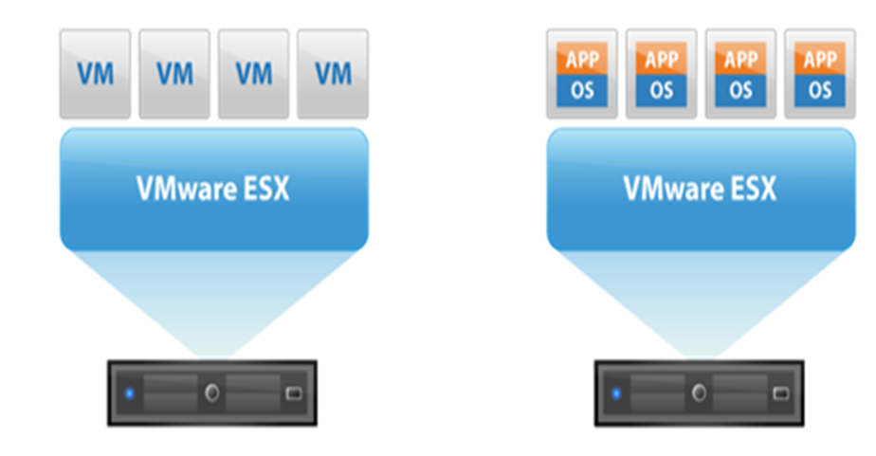

Slide 28
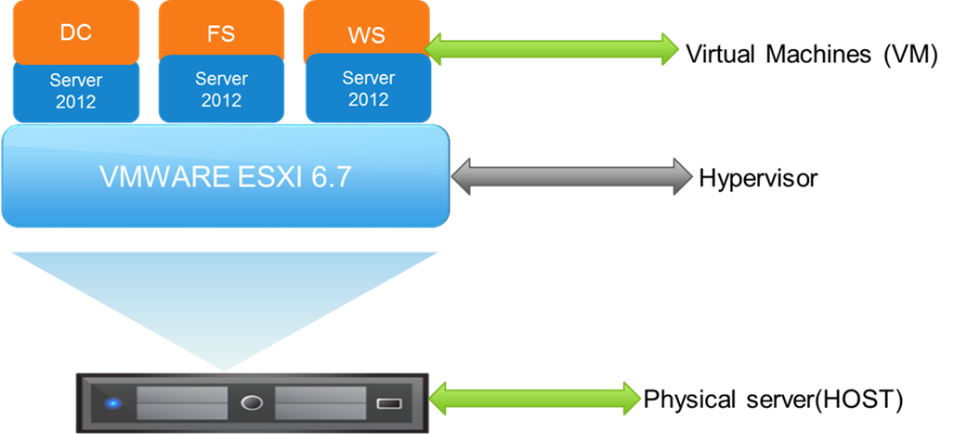

Slide 29
VMWARE Clustering
In VMWARE, a cluster is a collection of ESXi hosts configured to share their resources, Clusters are used to enable some of the more powerful features in vSphere, such as memory, CPU and storage. High Availability (HA), Distributed Resource Scheduler (DRS), Fault Tolerance (FT), and vMotion

Slide 30
Vcenter server
Vcenter Server- Is use to centrally manage multiple ESXI hosts and their virtual machines. vCenter Server provides centralized management of ESXI hosts and virtual machines from a single console. It gives administrators deep visibility into the configuration of the critical components of a virtual infrastructure—all from one place. With vCenter Server, the entire virtual environments are easier to manage.

Slide 31
Vcenter server
Vcenter Server advantages:
It enables us to do V-motion
It enables the feature of DRS
It enables High Availability
It enables clustering
Vsphere update manager

Slide 32
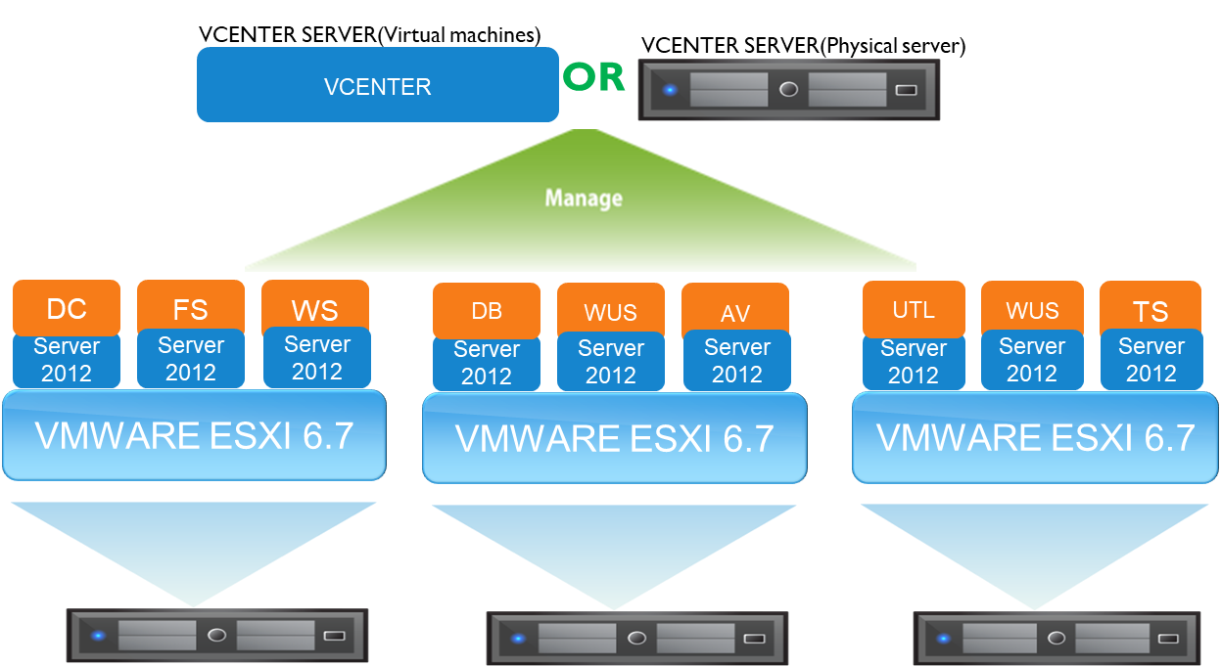

Slide 33
Vcenter Features- Vmotion
Vmotion- Is process of moving Virtual machines (VM) from one ESXI host to another ESXI host. The are two types of Vmotion;
1. Live migration -Allows you to move an entire running virtual machine from one physical server (ESXI host) to another, with no downtime. The virtual machines remains on with its full functionality while it migrates from one ESXI host to another. It retains its network identity and connections, ensuring a seamless migration process.

Slide 34
Vcenter Features- Vmotion
2. Cold Migration- This type of migration allows you to move power-off virtual machines from one ESXI host to another. Before Migration, the virtual machine must be shutdown.
In a migration process, All technical requirements must be met between the two host as well as the Vcenter server.

Slide 35
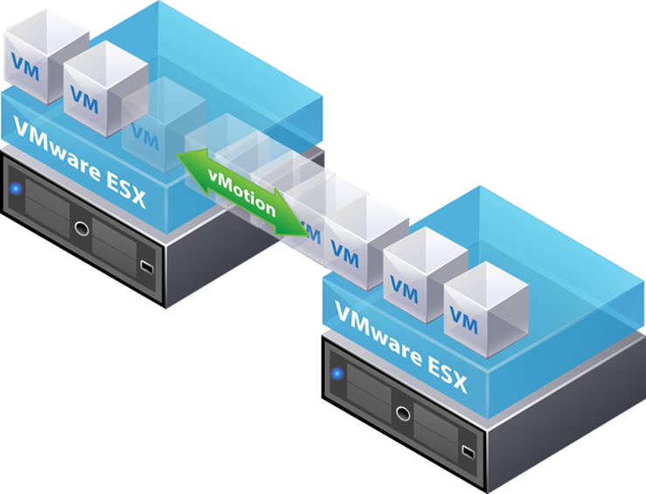

Slide 36
Distributed resources scheduler
Is a feature in Vcenter cluster that provides load balancing by migrating VMs from a heavily loaded ESXi host to another host that has enough computing resources, all while the VMs are still running. This is used to prevent overloading of ESXi hosts.

Slide 37
Distributed resources scheduler
Virtual machines can have uneven workloads at different times, and if an ESXi host is overloaded, performance of all VMs running on that host is reduced. The VMware DRS cluster helps in this situation by providing automatic VM migration

Slide 38
Distributed resources scheduler
Key features of DRS;
Load balancing-Utilization of processor and memory resources by each VM, as well as the load level of each ESXi host within the cluster, is continuously monitored. The DRS checks the resource demands of VMs and determines whether there is a better host for the VM to be placed on. If there is such host, the DRS makes a recommendation to migrate the VM in automatic or manual mode, depending on your settings. The DRS generates these recommendations every 5 minutes if they are necessary.

Slide 39
Distributed resources scheduler
Distributed Power Management Is a power-saving feature that compares the capacity of cluster resources to the resources utilized by VMs within the cluster. If there are enough free resources in the cluster, then DPM recommends migrating the VMs from lightly loaded ESXi hosts and powering off those hosts.

Slide 40
Distributed resources scheduler
Affinity and anti-affinity rules This feature allows you to spread a group of virtual machines across different ESXI hosts or keep a group of virtual machines on a particular host.
An affinity rule places a group of virtual machines on a specific host so you can easily audit the usage of those virtual machines. An anti-affinity rule places a group of virtual machines across different ESXI hosts, which prevents all virtual machines from failing at once in the event that a single host fails.

Slide 41
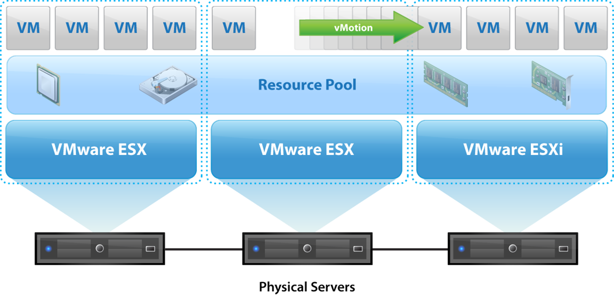

Slide 42
High Availability (HA)
HA (High Availability) is a feature that restart failed virtual machines (VMs) on alternative host servers to reduce downtime. HA enables an administrator to pool physical servers on the same network into a logical group called a high availability cluster. During a server failure, such as a system crash, power interruption or network failure, vSphere HA detects which VMs are down and restarts them on another stable system within the cluster. This process of restarting failed workloads on secondary ESXI host is called failover

Slide 43
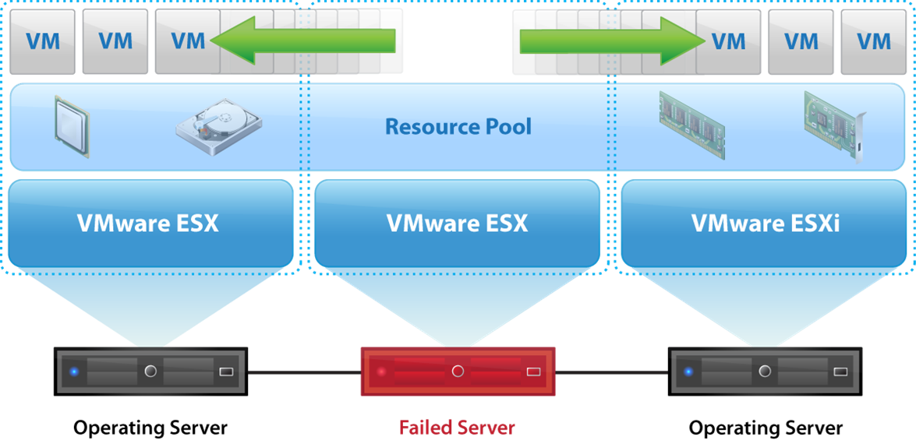

Slide 44
VMWARE Vsphere update manager
Vsphere Update Manager enables centralized update for the entire Vsphere infrastructure.
The following tasks can be perform:
Upgrade and patch ESXi hosts.
Install and update third-party software on hosts.
Upgrade virtual machine hardware, VMware Tools, and virtual appliances.
tracks vulnerabilities within the virtual infrastructure and automatically applies user-defined patches to eliminate those vulnerabilities.
Notes:
The cash-dispensing mechanism has an electric eye that counts each bill as it exits the dispenser. The bill count and all of the information pertaining to a particular transaction is recorded in a journal.
Besides the electric eye that counts each bill, the cash-dispensing mechanism also has a sensor that evaluates the thickness of each bill. If two bills are stuck together, then instead of being dispensed to the cardholder they are diverted to a reject bin. The same thing happens with a bill that is excessively worn, torn, or folded.

Slide 45
Vcenter Components
A vCenter Server instance consist of the following components:
vSphere Client and vSphere Web Client – tools that can be used to manage your vCenter Server. vSphere Web Client is the recommended way to manage an ESXi host when the host is managed by vCenter Server.
vCenter Server database – stores the inventory items, security roles, resource pools, performance data, and other information. Oracle and Microsoft SQL Server are supported databases for vCenter Server.
vCenter Single Sign-On (SSO) – allows authentication against multiple user repositories, such as Active Directory or Open LDAP.
Managed hosts – ESXi hosts and their respective virtual machines.
A single vCenter Server instance can support a maximum of 1,000 hosts, 10,000 powered-on virtual machines and 15,000 registered virtual machines.
Notes:
The cash-dispensing mechanism has an electric eye that counts each bill as it exits the dispenser. The bill count and all of the information pertaining to a particular transaction is recorded in a journal.
Besides the electric eye that counts each bill, the cash-dispensing mechanism also has a sensor that evaluates the thickness of each bill. If two bills are stuck together, then instead of being dispensed to the cardholder they are diverted to a reject bin. The same thing happens with a bill that is excessively worn, torn, or folded.

